Slide 1
Leveraging Azure to Build Notification Based Apps
Presented by David Ginn
6/29/2016

Slide 2
Agenda
Introduction
Lightning Talk
‘Introduction to Azure Service Fabric’
Q & A
Survey Prizes
Notes:
Briefly mention the prizes.
MS Band
Spher0 2.0
Cloud Monix
GC

Slide 3
Organizers
Notes:
Tom Straub
Eric Webb
Adam Howard
Kris Phillips

Slide 4
Mission
Notes:
The Cincinnati User Group exists to help developers, infrastructure engineers, and architects understand the Azure platform across it's full breadth of capabilities. Anything in Azure is fair game, including Infrastructure as a Service (IAAS), Platform as a Services (PAAS), Remote Apps, and all of the other wonderful capabilities that are in Microsoft's cloud platform.

Slide 5




Sponsors
Notes:
Microsoft – Office Space
Cloud Monix – Free credits
Cardinal Solutions – Food and drinks

Slide 6
Lightning Talk
How are you using Azure?
Notes:
Engage the audience, get general azure experience from everyone, spark some small conversations
Ask about topics that interest the audience
Purpose: Get people talking/comfortable. Also gain insight into future topic suggestions.

Slide 7
Leveraging Azure to Build Notification Based Apps
Notes:
INSERT TOPIC NAME

Slide 8
DEMO TIME!
Building an end-to-end notification app in 15 minutes!

Slide 9
Sample App Technology Stack

Slide 10
Windows Universal App
Run on any Windows 10 Device (Phone, Tablet, PC)
Register tags with Notification Hub
User_davidmginn
Location_Cincinnati
Subject_Azure

Slide 11
ASP.NET Web API
Build Web APIs on top of the .NET Framework
Sends message to Azure Service Bus

Slide 12
Azure Service Bus
Messaging Service in the Cloud
Scalable

Slide 13
Web Job
Receives message from Service Bus
Web Jobs SDK
Always Running, Scheduled, On-demand
Sends push notification upon completion

Slide 14
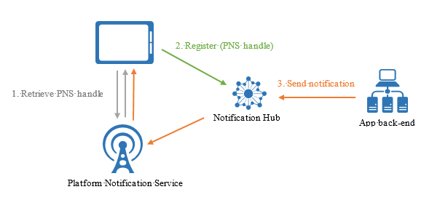
Azure Notificaton Hub
Abstraction
iOS
Android
Windows
More…

Slide 15
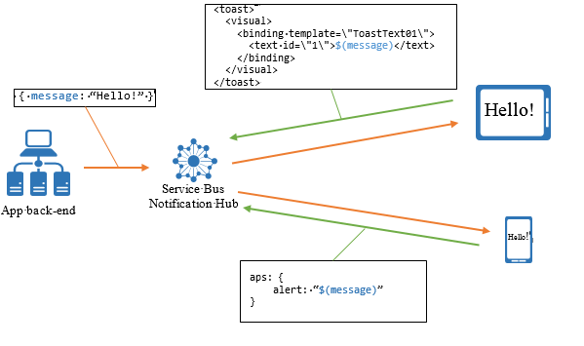
Cross Platform Notifications
Register template
Push key/value pairs

Slide 16
Q/A
Notes:
https://www.random.org/integers/?num=1&min=1&max=100&col=5&base=10&format=html&rnd=new

